Slide 1
Systematic errors consideration in FS and QFS options
Yury Senichev
Notes:
PAC 2009, Yu. Senichev

Slide 2
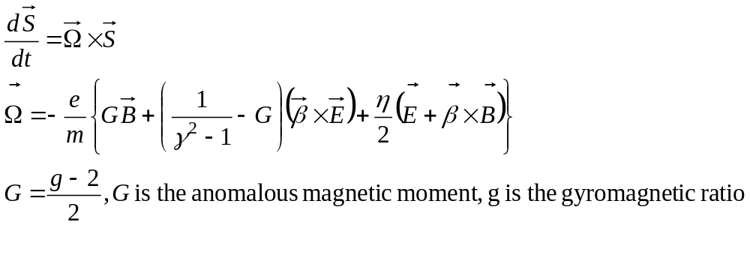

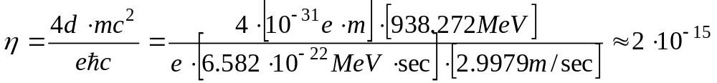
Basic principle of EDM measurement in ring comes from “Thomas-Bargmann, Michel,Telegdi” equation with EDM term
The spin is a quantum value, but in the classical physics representation the “spin” means an expectation value of a quantum mechanical spin operator:
MDM
EDM

Slide 3
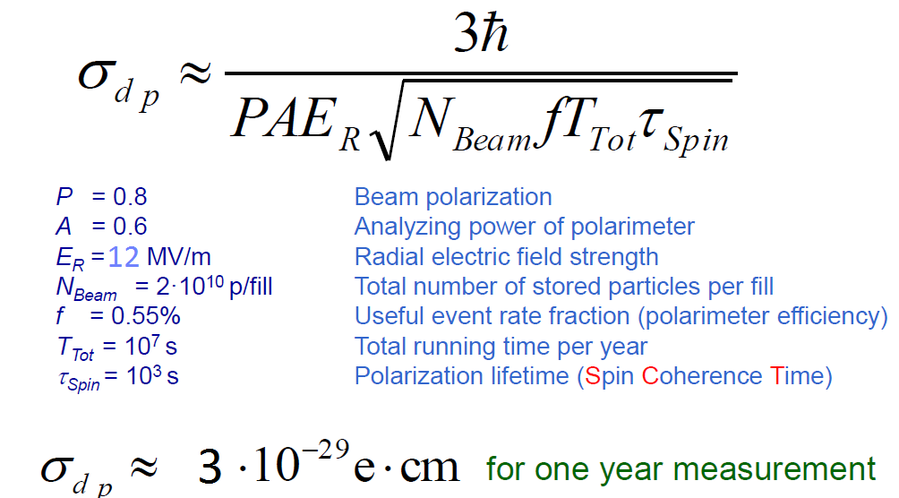
Sensitivity of EDM experiment

Slide 4
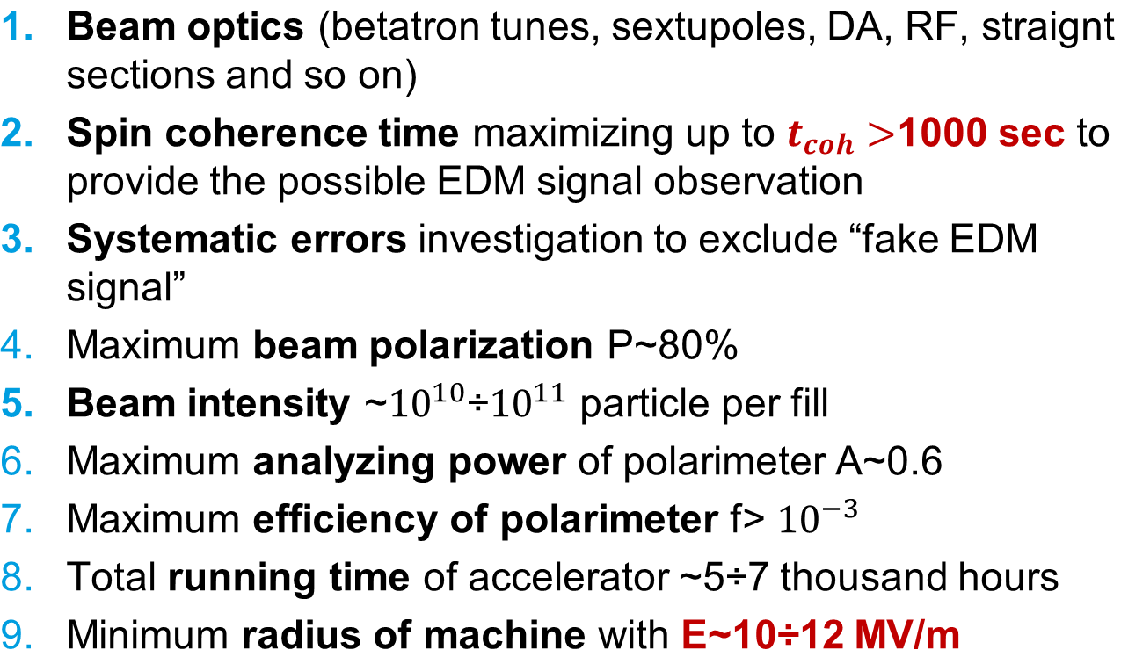
To design the new EDM ring we should solve the next problems

Slide 5
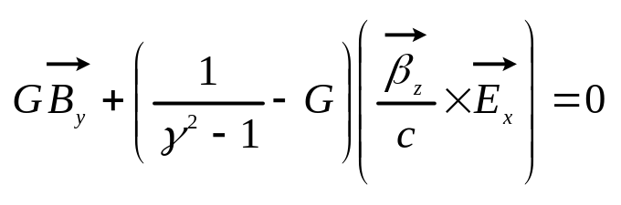

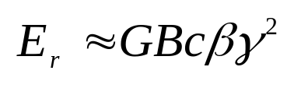
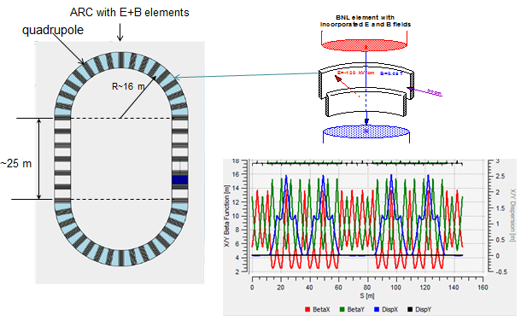
Frozen Spin lattice for deuteron
  The condition of the zero MDM spin precession frequency in FS lattice [1,2]
  creates the relation between E and B fields in incorporated bending elements:
Frozen Spin lattice based on B+E elements and TWISS functions

Slide 6
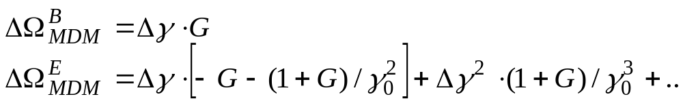
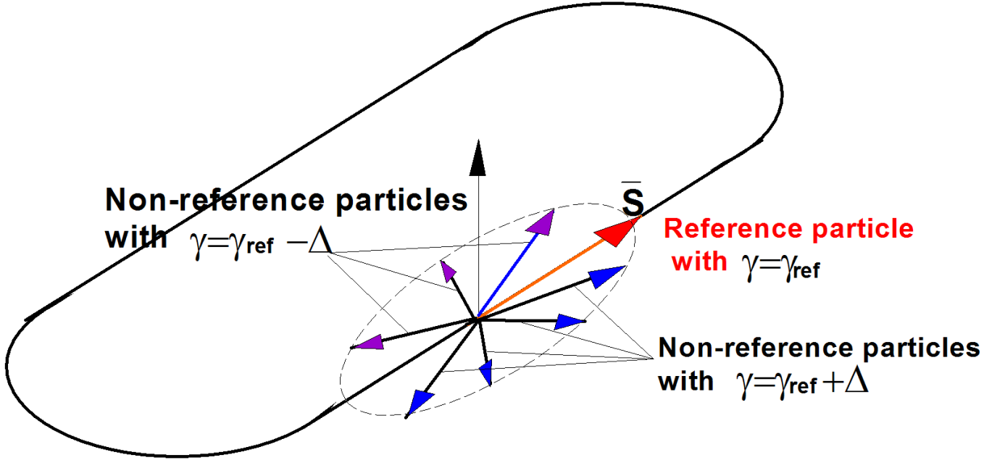
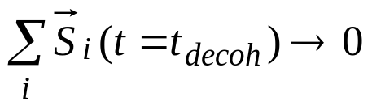
Spin tune coherence
In magnetic field
In electric field

Slide 7
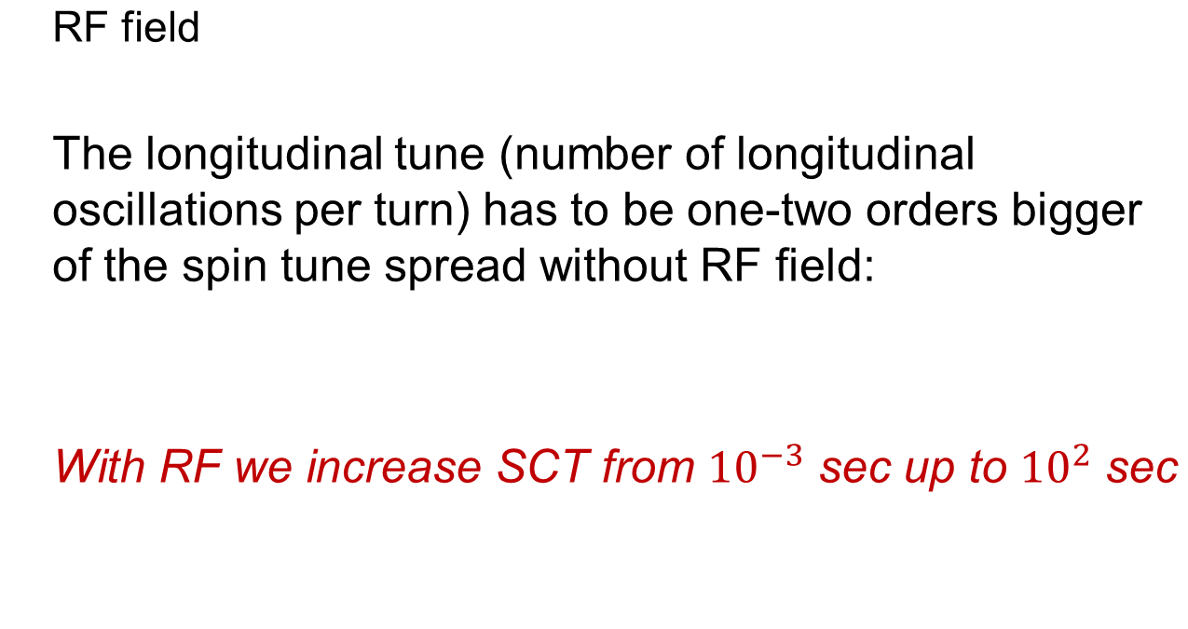

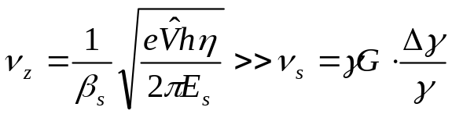
Spin tune coherence :
RF field as a method for mix particles of energy

Slide 8
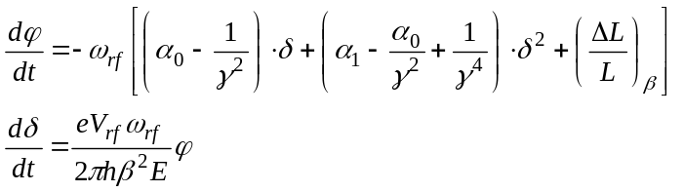
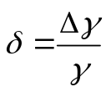
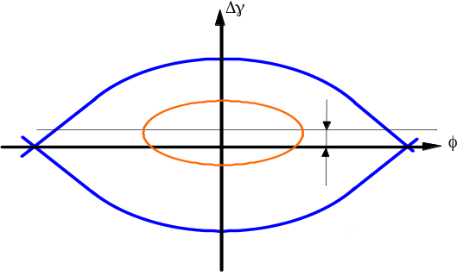
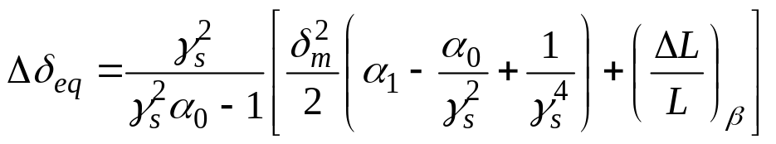
Spin tune coherence: 3D dependence
Equation of Longitudinal motion:
x and y orbit lengthening
nonlinear term of energy oscillation
Nonlinear
Z motion
Betatron
motion

Slide 9
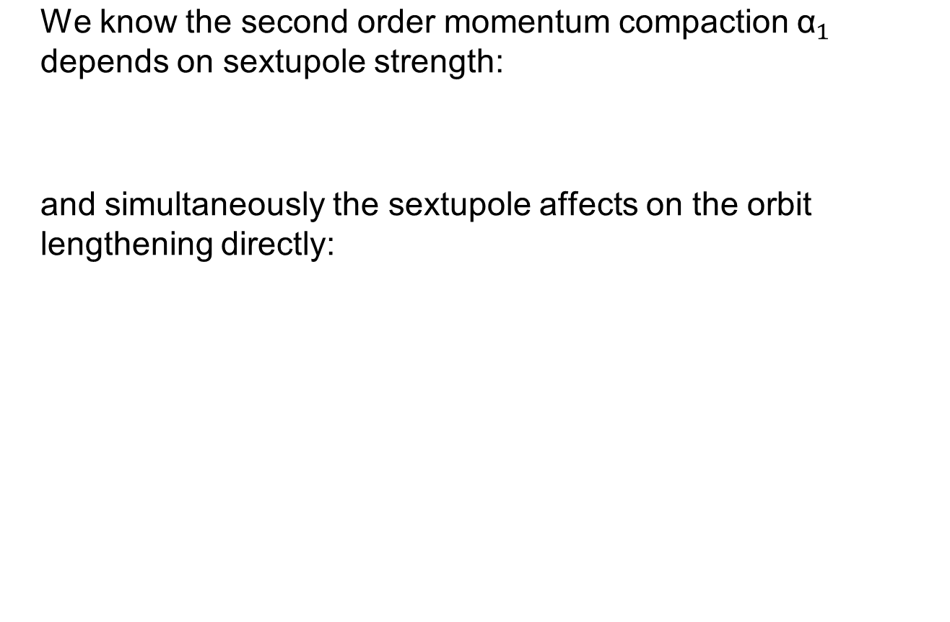
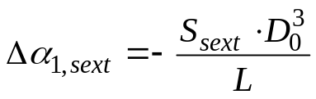
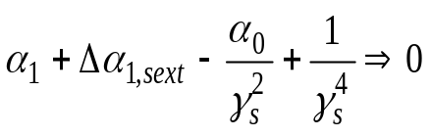
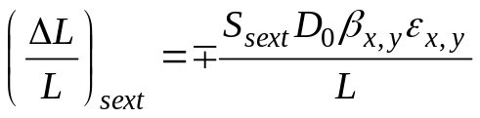
Spin tune coherence: sextupole correction

Slide 10

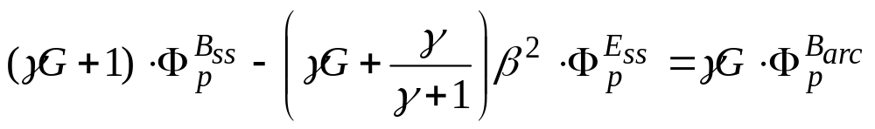
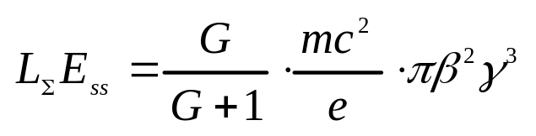
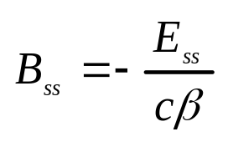
Quasi-Frozen Spin (QFS) method for deuteron
From T-BMT equations follows that the growth of the EDM signal is directly dependent on the angle between the spin and momentum direction.
Exact fulfillment of the frozen spin condition is not required. We need an equal deviation of spin in magnetic and electric fields totally on the ring
To realize the quasi-frozen spin concept, we have to fulfil the condition:
The basic relations are:

Slide 11
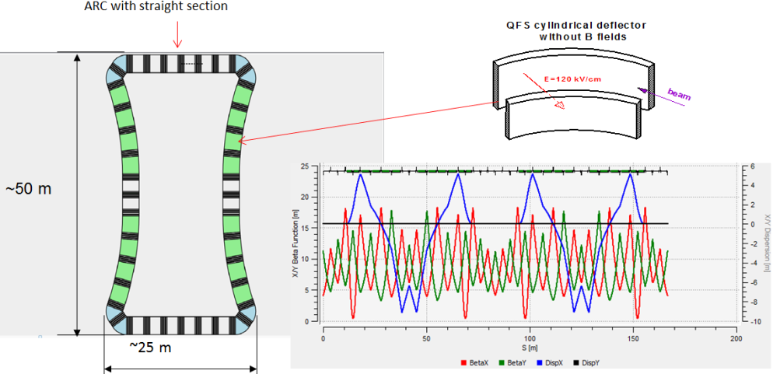
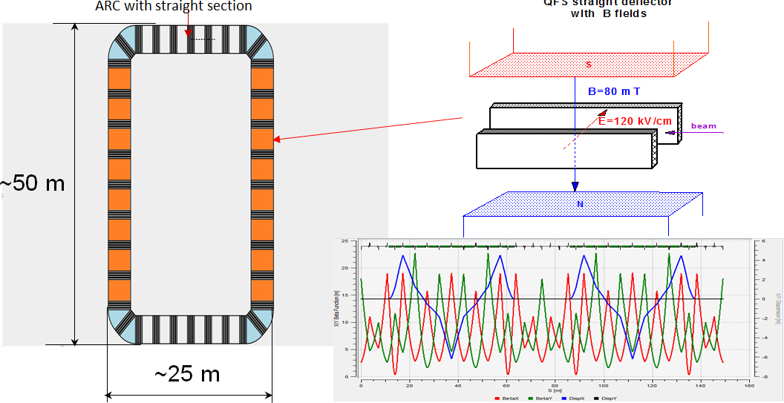

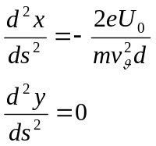
QFS lattice
In QFS lattice we introduced a magnetic field of small value ~80 mT, compensating the Lorentz force of the electric field in electrostatic deflector located on the straight sections.
Ring lattice based on QFS concept: ring view with main elements and TWISS functions

Slide 12
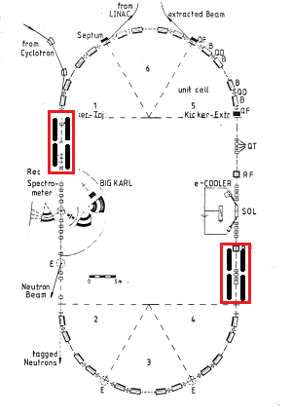
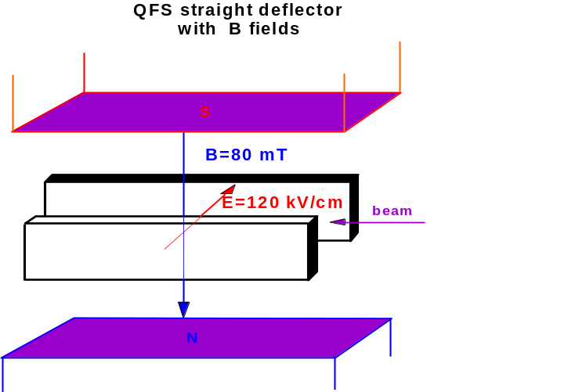
QFS in COSY ring
In precursor experiment we do not need a large statistics and we can start working on energy 75 MeV. This allows to use only 4 “E+B” straight elements, which is four times less than at 270 MeV. The total length is 2x7 m. Further, E+B elements can be used for a full scale experiment at 270 MeV. In result, it will provide Quasi Frozen Spin at energy of 75 MeV. Due to small B field value the E+B elements on the straight sections may be made using ordinary electrical coils with field 120-100 mT. The condition for spin recovery is fulfilled using E field (working regime <120 kV/cm).
.

Slide 13
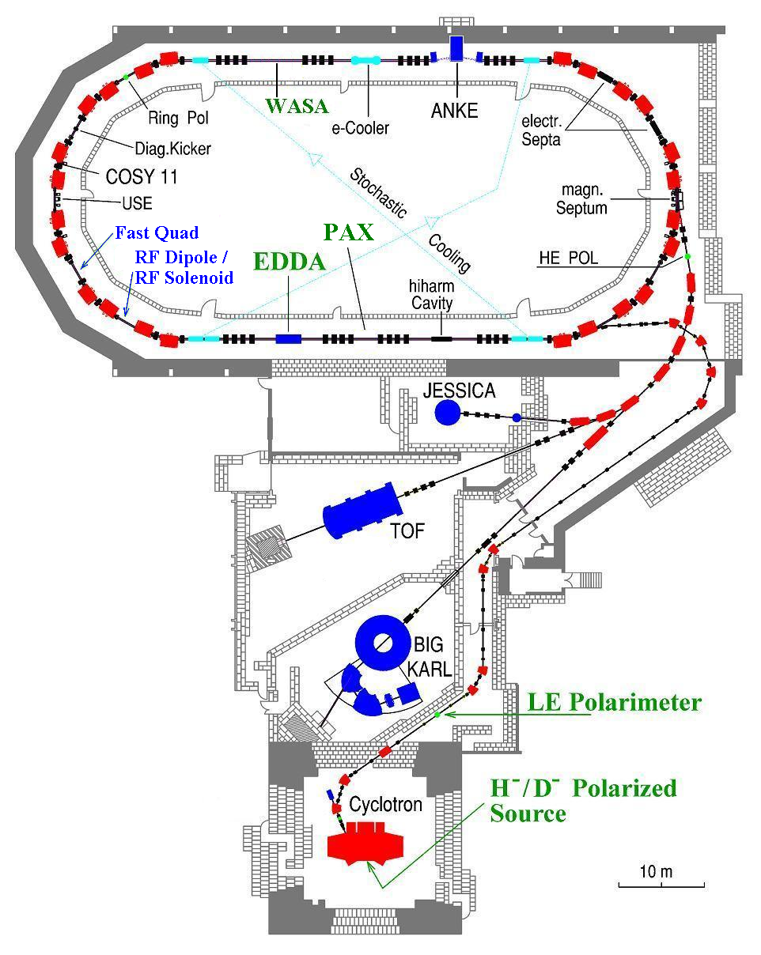
Cooler Synchrotron COSY
Siberian
Snake
At 270 MeV the total length of straight deflectors is 28 m
with E=12 MV/m and B=80 mT
and
at 75 MeV the total length of straight deflectors is 7 m
with E=12 MV/m and B=140 mT
2MV
Electron
Cooler
CW
here
CCW
or here

Slide 14
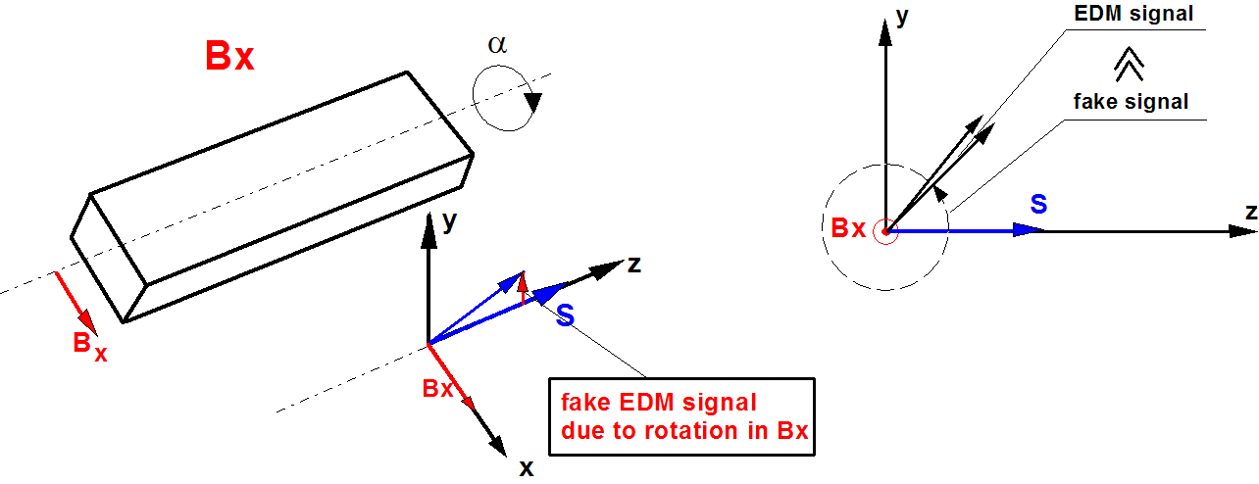
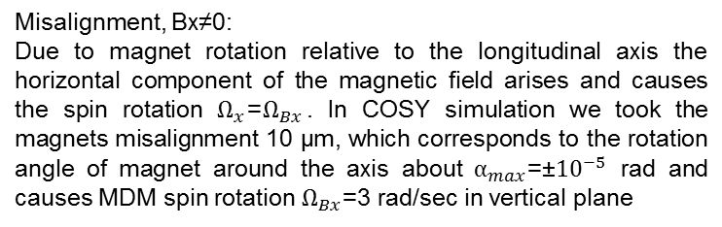

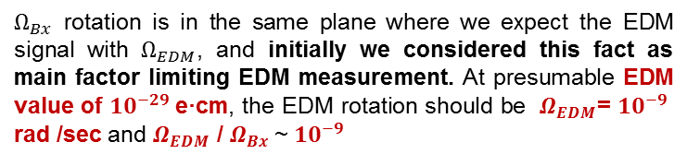

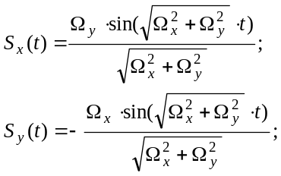


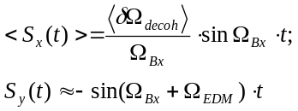

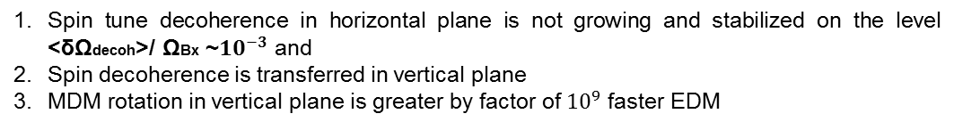
Systematic errors due to magnet rotation around the longitudinal axis (Bx≠0 ΩBx, ≠0, Ωy=<Ωdecoh>)
For initial condition
from T-BMT equations:
Notes:
PAC 2009, Yu. Senichev

Slide 15
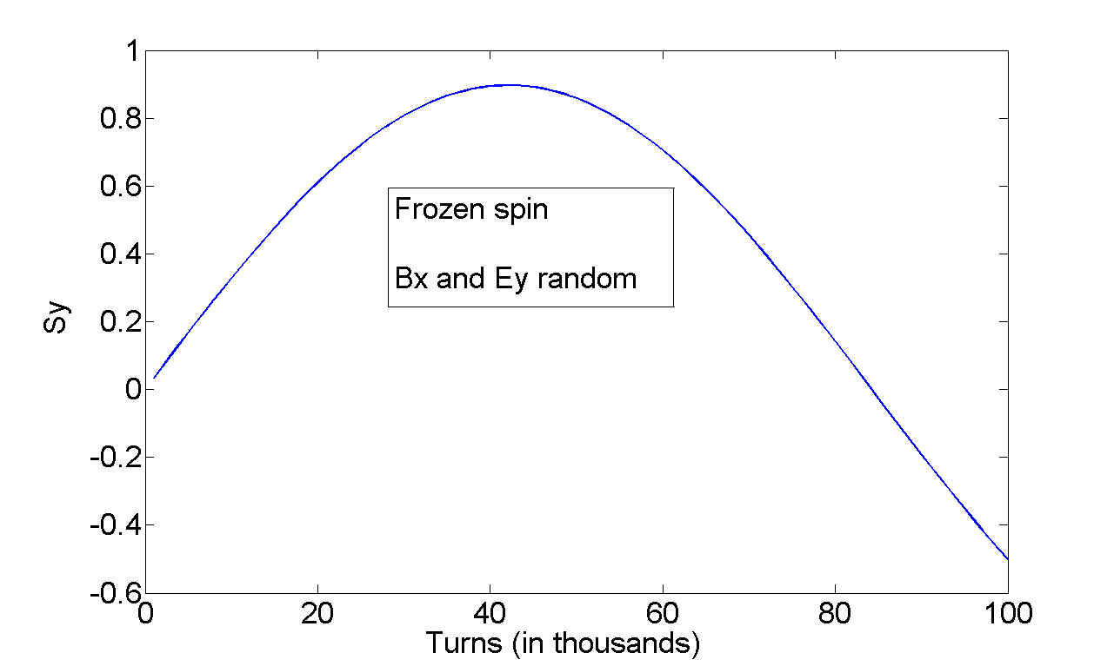

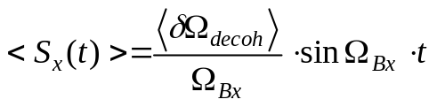

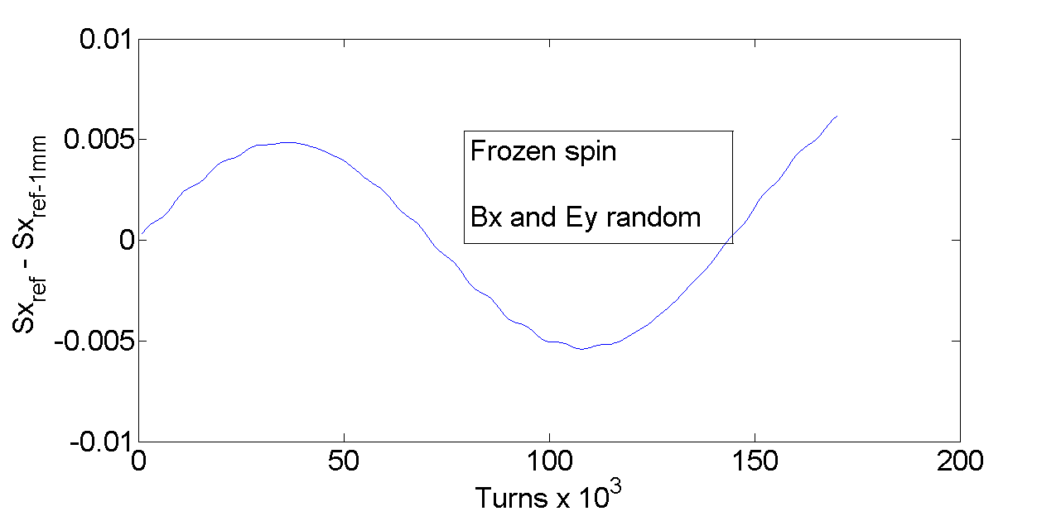
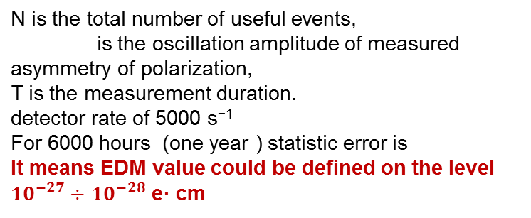


COSY Inf+MODE simulation of systematic errors due to magnet rotation around the longitudinal axis
Coherent component
Sensitivity
Parameters of decoherent component

Slide 16
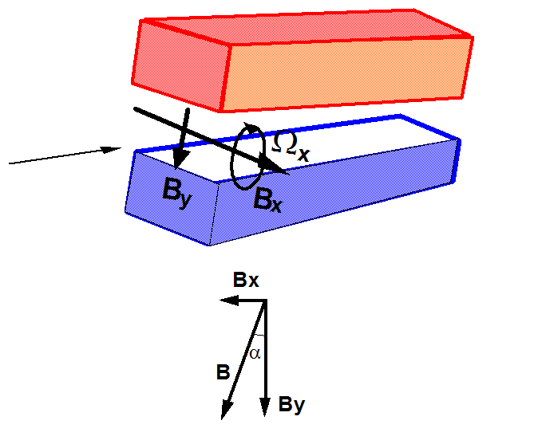



The best way to get rid of the enemy - make him a friend, or how to use systematic errors to measure EDM in CW+CCW procedure
To split out the EDM signal from the sum signal we use CW+CCW procedure:
Calibration of Bx throught By
Measurement of the total spin frequency in the experiment with a counter clock-wise (CW) direction of the beam
Installation of B field after the polarity change using calibration
Measurement of the total spin frequency in the experiment with a counter clock-wise (CCW) direction of the beam
Compare CCW with clock-wise (CW) measurements
The difference determines the accuracy of the EDM measurement. Calibrating Bx we can minimize up to value of calibration accuracy.

Slide 17


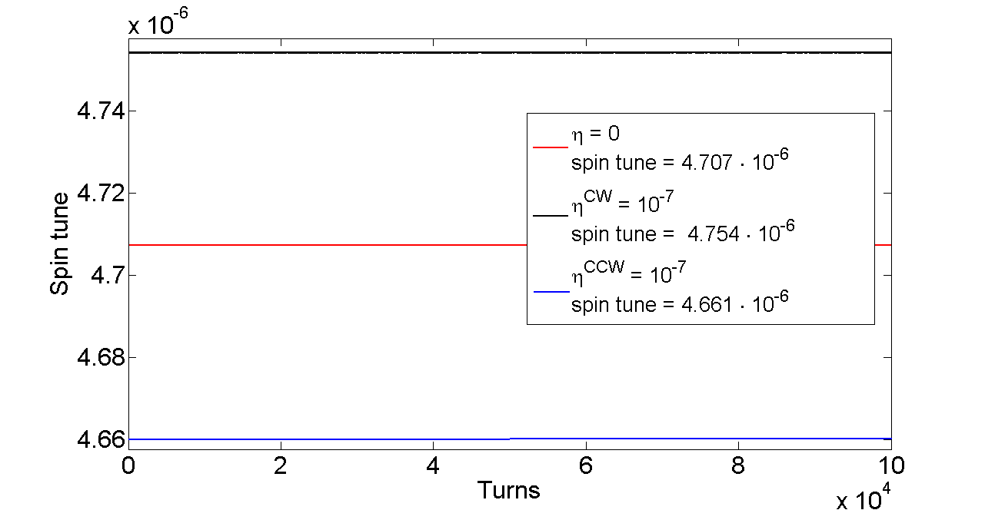

Bx and By calibration procedure
First, we suggest calibrating the field of the magnets using the relation between the beam gamma and the spin precession frequency in the horizontal plane, that is, determined by the vertical component By. Since the magnet orientation remains unchanged, and the magnets are fed from one power supply, the calibration of By will restore the component Bx with the same relative accuracy 10^(-9), that is the difference as well. Such procedure does not involve EDM signal.
If we assume that we can measure the spin frequencies with an accuracy of 10^(-9) already experimentally demonstrated in COSY and reach the calibration accuracy of Bx up to 10^(-9) we will be able to determine the EDM frequency up to 10^(-9) rad/sec, which corresponds to the EDM measurement on the level of 10^(-28)÷10^(-29) e·cm
the results of a numerical simulation of the EDM measurement procedure, we took the EDM 10^(-21), that is

Slide 18
Bx coil
Nevertheless, the fundamental question of how to calibrate the field By using the spin tune measurement in a horizontal plane, if due to misalignments the spin rotates in the vertical plane with relatively high frequency ~3 rad/sec, remains. To solve this problem, we plan for the calibration time only to introduce the inhibitory vertical field, for example by means of a horizontal coil. Having inhibited rotation in the vertical plane to the reasonable value of ~0.1 rad/sec and calibrated, then we turn off the coil. In this case we do not need to know the value of the field in the coil
Nevertheless introducing the coil we can modify the integral value of the guiding magnetic field By. Let us estimate this value. We know that due to misalignment of magnets with an accuracy of 10 micrometer, we have in Bx/By = 10 ^(-)6. Obviously the coil can be installed with the same accuracy and By(coil)/Bx(coil)=10^(-6). Thus, the coil introduces in By of ring 10^(-12)

Slide 19
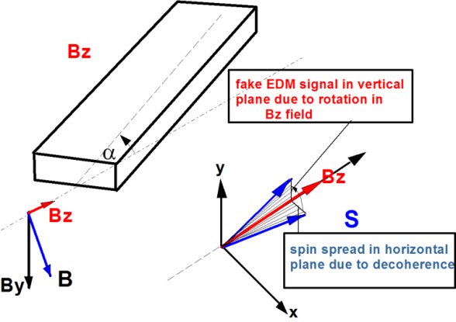

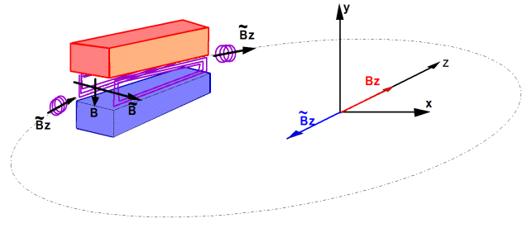





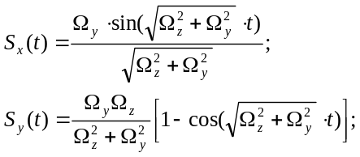

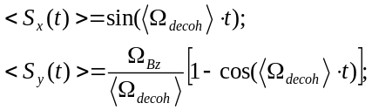
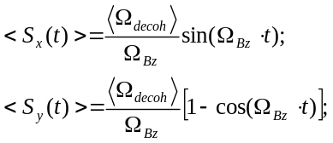
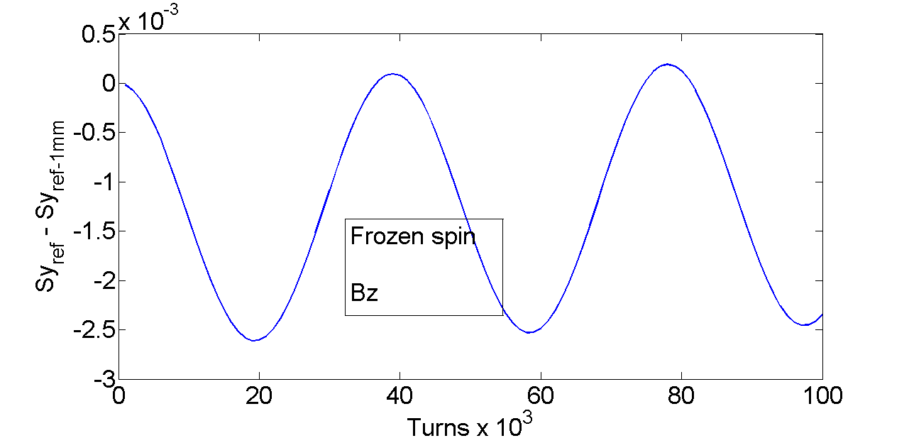
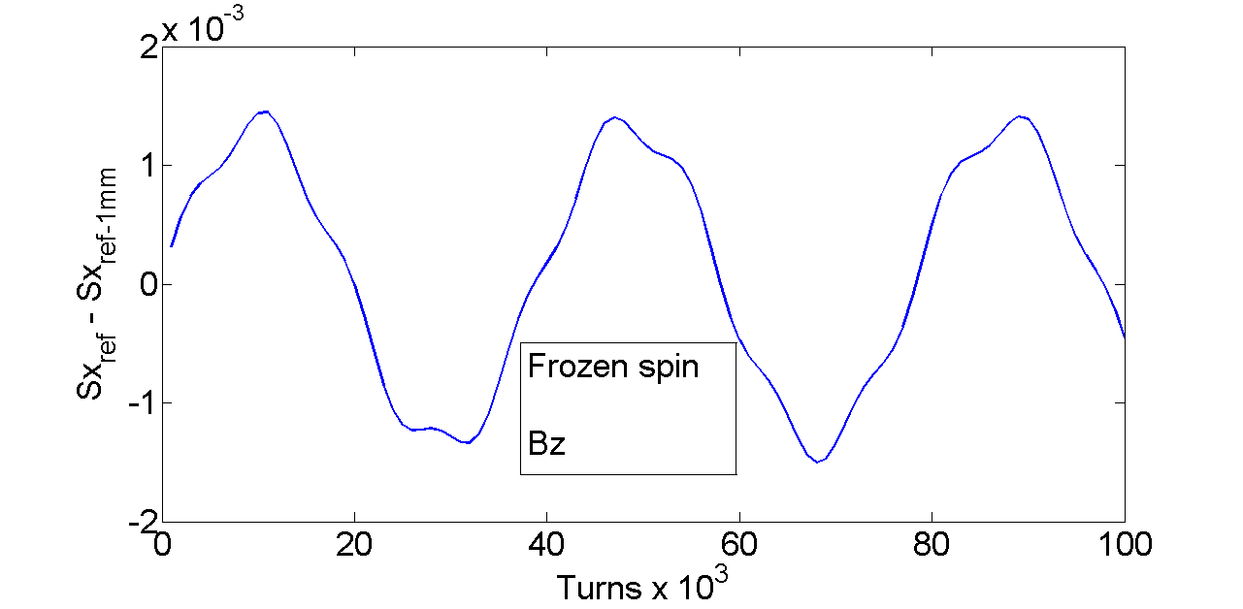

Systematic errors due to magnet rotation around the transverse axis (Bz≠0 Ωz, ≠0, Ωy=<Ωdecoh>)
The longitudinal component of field is most undesirable as it transforms the spin decoherence from the horizontal plane into the vertical plane where we expect a signal of EDM. The fake signal depends on the ratio between
Because of the oscillations around the longitudinal axis the EDM signal periodically changes the sign of growth. Therefore, the only way is to minimize the longitudinal component of the magnetic field with
For initial condition
from T-BMT equations:
MODE 3D simulation
In the experiment of Ed the vertical component increases with rate

Slide 20
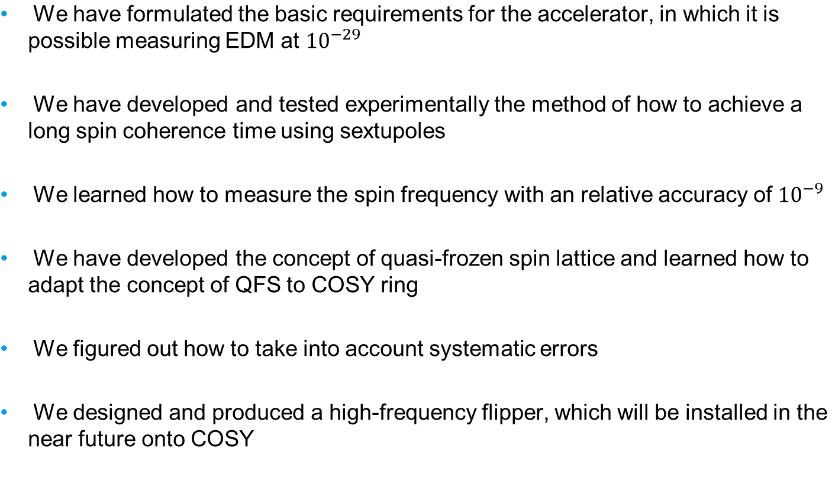
Conclusion

Slide 21


